Slide 1

Data Transfer
Schemes

Slide 2
Why do we need data transfer schemes ?
Availability of wide variety of I/O devices because of variations in manufacturing technologies e.g. electromechanical, electrical, mechanical, electronic etc.
Enormous variation in the range of speed.
Wide variation in the format of data.

Slide 3
Classification of Data Transfer Schemes
Data transfer schemes
Programmed
Data transfer
DMA
Data transfer
Synchronous
mode
Asynchronous
mode
Interrupt
Driven mode
Block
DMA mode
Cycle stealing
DMA mode

Slide 4
Programmed Data Transfer Scheme
The data transfer takes place under the control of a program residing in the main memory.
These programs are executed by the CPU when an I/O device is ready to transfer data.
To transfer one byte of data, it needs to execute some instructions.
This scheme is very slow and thus suitable when small amount of data is to be transferred.

Slide 5
Programmed data transfer
Programmed data transfer is written and controlled by programmer and executed by the processor.
The data transfer between processor and I/O devices or vice versa takes place by executing the corresponding instruction/program.
Programmed I/O data transfers are identical to read and write operations for memories or devices.
Example instructions – MOV M,A, IN 01, OUT 02 etc.

Slide 6
Programmed data transfer contd..
The execution of programmed data transfer can take place at predefined period determined by the programmer.
Based on the time of execution of the data transfer instruction, the programmed data transfer is divided into following three types namely:
  Synchronous mode of data transfer
  Asynchronous mode of data transfer
  c) Interrupt driven data transfer

Slide 7
Synchronous Mode of Data Transfer
Its used for I/O devices whose timing characteristics are fast enough to be compatible in speed with the communicating Processor.
In this case the status of the I/O device is not checked before data transfer.
The data transfer is executed using IN and OUT instructions.

Slide 8
In simple or synchronous mode, the data is read, from the input device, by the processor irrespective of the status of the input device.
It is assumed that the input device is ready with the data as and when the processor reads the data and the input device is in synchronism with the processor.
Similarly, the data is written onto the output device irrespective of its status assuming that the output device is in synchronism with the processor.

Slide 9
Memory compatible with Processors are available. Hence this method is invariably used with compatible memory devices.
The I/O devices compatible in speed with Processor are usually not available. Hence this technique is rarely used for I/O.

Slide 10
Asynchronous Data Transfer
This method of data transfer is also called Handshaking mode.
This scheme is used when speed of I/O device does not match with that of Processor and the timing characteristics are not predictable.
The Processor first sends a request to the device and then keeps on checking its status.

Slide 11
The data transfer instructions are executed only when the I/O device is ready to accept or supply data.
MPU initiates the I/O devices and then continuously checks the status of I/O devices till the I/O device becomes ready. Each data transfer is preceded by a requesting signal sent by MPU and READY signal from the device.
In this mode of data transfer, the data is read from an input device when the processor or CPU is ready and executes the data transfer instruction.
If the input device is not ready the processor will wait until the device is ready with data.

Slide 12
Similarly, the data is written onto an output device by the processor when it executes the data ‘write’ instruction to the corresponding output device.
The program is written and the processor will wait in a loop until the output device is ready to receive data.
As it can be seen clearly, the processor’s time is wasted in this mode of data transfer as it waits for the device to be ready.

Slide 13
Disadvantages
A lot of Processor time is wasted during looping to check the device status which may be prohibitive in many time critical situations.
Some simple devices may not have status signals. In such a case Processor goes on checking whether data is available on the port or not. e.g a keyboard interfaced to MPU.

Slide 14
Interrupt driven data transfer
Basic Interrupt Structure
Interrupt is a mechanism by which the processor is made to transfer control from its current program execution to another program of more importance or higher priority.
The interrupt signal may be given to the processor by any external peripheral device.
Interrupts are, in general, generated by a variety of sources either internal or external to the CPU.
Interrupts are the primary means by which Input and Output devices obtain the services of the CPU.

Slide 15
Types of Interrupts
Interrupts can be classified in the following ways:
1. Vectored and Non-vectored Interrupts
2. Maskable and Non-maskable Interrupts
3. Software and Hardware Interrupt
    Vectored (the address of the service routine is hard-wired)
    Non-vectored (the address of the service routine needs to be supplied externally by the device)

Slide 16
Interrupts…
An interrupt is considered to be an emergency signal that may be serviced.
  The Microprocessor may respond to it as soon as possible.
What happens when MP is interrupted ?
  When the Microprocessor receives an interrupt signal, it suspends the currently executing program and jumps to an Interrupt Service Routine (ISR) to respond to the incoming interrupt.
  Each interrupt will have its corresponding ISR.

Slide 17
Responding to Interrupts
Responding to an interrupt may be immediate or delayed depending on whether the interrupt is maskable or non-maskable.
There are two ways of redirecting the execution to the ISR depending on whether the interrupt is vectored or non-vectored.
  Vectored: The address of the subroutine is already known to the Microprocessor
  Non Vectored: The device will have to supply the address of the subroutine to the Microprocessor accordingly.

Slide 18
The 8085 Interrupts
When a device interrupts, it actually wants the MP to give a service which is equivalent to asking the MP to call a subroutine. This service subroutine is called ISR (Interrupt Service Routine or Interrupt Service Subroutine).
The maskable interrupt process in the 8085 is controlled by a single flip flop inside the microprocessor. This Interrupt Enable flip flop is controlled using the two instructions “EI” and “DI”.
The 8085 has a single Non-Maskable interrupt i.e. TRAP.
  The non-maskable interrupt is not affected by the value of the Interrupt Enable flip flop.

Slide 19
The 8085 Interrupts
The 8085 has 5 interrupt input pins.
  The INTR input.
    The INTR input is the only non-vectored interrupt.
    INTR is maskable using the EI/DI instructions.
  RST 5.5, RST 6.5, RST 7.5 are all automatically vectored.
    RST 5.5, RST 6.5, and RST 7.5 are all maskable.
  TRAP is the only non-maskable interrupt in the 8085
    TRAP is also automatically vectored.

Slide 20
The 8085 Interrupts
Interrupt name | Maskable | Vectored
INTR | Yes | No
RST 5.5 | Yes | Yes
RST 6.5 | Yes | Yes
RST 7.5 | Yes | Yes
TRAP | No | Yes

Slide 21
The 8085 Maskable/Vectored Interrupts
The 8085 has 4 Masked and 4 Vectored interrupt inputs.
  RST 5.5, RST 6.5, RST 7.5
    They are all maskable.
    They are automatically vectored according to the following table:
      The vectors for these interrupt fall in between the vectors for the RST instructions. That’s why they have names like RST 5.5 (RST 5 and a half).
Interrupt | Vector
RST 5.5 | 002CH
RST 6.5 | 0034H
RST 7.5 | 003CH
TRAP | 0024H

Slide 22
Interrupt Vectors and the Vector Table
An interrupt vector is a pointer to where the ISR is stored in memory.
All interrupts (vectored or otherwise) are mapped onto a memory area called the Interrupt Vector Table (IVT).
  The IVT is usually located in memory page 00 (0000H - 00FFH).
  The purpose of the IVT is to hold the vectors that redirect the microprocessor to the right place when an interrupt arrives.

Slide 23
The 8085 Non-Vectored Interrupt Process
The 8085 recognizes 8 RESTART instructions: RST0 - RST7.
  each of these would send the execution to a predetermined memory location on page 00:
Restart Instruction | Equivalent to
RST0 | CALL 0000H
RST1 | CALL 0008H
RST2 | CALL 0010H
RST3 | CALL 0018H
RST4 | CALL 0020H
RST5 | CALL 0028H
RST6 | CALL 0030H
RST7 | CALL 0038H

Slide 24
The 8085 Non-Vectored Interrupt Process
The interrupt process should be enabled using the EI instruction.
The 8085 checks for an interrupt during the execution of every instruction.
If INTR is high, MP completes current instruction, disables the interrupt and sends INTA (Interrupt acknowledge) signal to the device that interrupted.
INTA allows the I/O device to send a RST instruction through data bus.
Upon receiving the INTA signal, the interrupting device is expected to return the op-code of one of the 8 RST instructions.

Slide 25
The 8085 Non-Vectored Interrupt Process
When the microprocessor executes the RST instruction, received from the device, it saves the address of the next instruction on the stack and jumps to the appropriate entry in the IVT (which is on the page 00).
6. The IVT entry must redirect the microprocessor to the actual service routine.
7. Microprocessor then Performs the ISR.
The service routine must include the instruction EI to re-enable the interrupt process.
9. RET instruction at the end of the ISR allows the MP to retrieve the return address from the stack and the program is transferred back to where the program was interrupted.

Slide 26
Example: Let , a device interrupts the Microprocessor using the RST 7.5 interrupt line.
  Because the RST 7.5 interrupt is vectored, Microprocessor knows, in which memory location it has to go.
  RST7.5 is equivalent to Call 003CH.
  Microprocessor goes to 003C location and will get a JMP instruction there with the actual ISR address.
  The Microprocessor will then, jump to the ISR location in the R/W memory and executes the ISR there and return back to the main program.

Slide 27
Interrupt Structure
The important points in the interrupt structure of any microprocessor are:-
The number and type of interrupt signals available.
The address of the memory where Interrupt Service Routine (ISR) is located for a particular interrupt signal. This address is called as Interrupt Vector address.
The masking and unmasking facility for the interrupt signals.
This facility allows the programmer to execute the interrupt service routine only when required.

Slide 28
Interrupt Structure contd..
The priority of interrupts when more than one interrupt signals are available.
Handling and storing of information on the stack, about the interrupted program (status information).
This information must be loaded in to CPU when interrupt service routine is executed and control RETURNS back from interrupt.
The control should transfer back to the next location of the interrupted program.

Slide 29
Interrupt Driven Data Transfer
In this scheme the Processor initiates an I/O device to get ready and then it executes its main program instead of remaining in the loop to check the status of the device.
When the device gets ready, it sends a signal to the MPU through a special input line called an interrupt line.
The Processor acknowledges the interrupt signal after completing/executing the current instruction.

Slide 30
The CPU responds to an interrupt request by a transfer of control to another program in a manner similar to a subroutine call.
The Processor saves the contents of the PC (address of the next instruction) and supplementary information about current state (flags, registers, etc.) on the stack first.
Load PC with the beginning address of an Interrupt Service Routine (ISR) in the IVT. Control then jump to the routine and then start executing it.
Finish ISR/ISS when return instruction is executed.
After returning from ISS, the Processor again loads the PC with the address that was earlier loaded in the stack and (other status information also) thus returns to the main program.

Slide 31
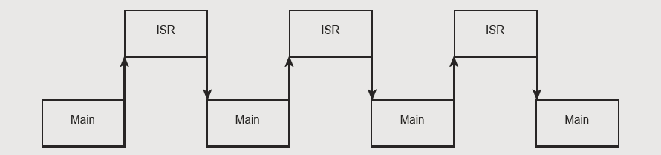
Transfer of control from Main program to ISR

Slide 32
It is efficient because precious time of Processor is not wasted while the I/O device gets ready.
In the earlier techniques, Processor has to either wait for the device to get ready or has to check the Ready status of device continuously.
In this scheme the data transfer may also be initiated by the I/O device.

Slide 33
Multiple Interrupts
1. The Processor has one interrupt level and several I/O devices to be connected to it which are attended in the order of priority.
2. The MPU has several interrupt levels and one I/O device is to be connected to each interrupt level.

Slide 34
3. The MPU has several interrupt levels and more than one I/O devices are to be connected to each interrupt level.
In this case the MPU executes multiple interrupts by using a device polling technique to know which device connected to which interrupt level has interrupted the processor.

Slide 35
Software Polling
Each I/O device is equipped with a status FF. The processor reads this status FF of each device according to some pre-assigned priority and checks whether it is set or not. This process is continued until one device is found with set status or the status checking of all I/O devices is exhausted. Then the ISS of the device with set status is invoked.
In this scheme the processor has an overhead for identifying the interrupting source, particularly, if the number of I/O devices is large.

Slide 36
To overcome the problem of software polling, another approach is used, called hardware polling.
Hardware Polling: External hardware circuit is used for this purpose. Programmable Interrupt Controller (PIC) chip is used with the processor to implement hardware polling.

Slide 37
Programmable Interrupt Controller (8259)
It (8259) is the Programmable Interrupt Controller.
It is a 28 pin IC
The 8259 is designed to relieve the system CPU from the task of polling in a multi-level priority system.
The high speed and industry standard configuration of the 8259 make it compatible with processors such as 8085, 8086, 80286 etc.
The 8259 can handle up to eight vectored priority interrupting sources and is cascadable to 64, without additional circuitry.

Slide 38
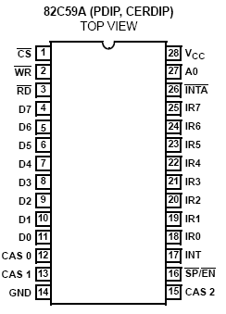
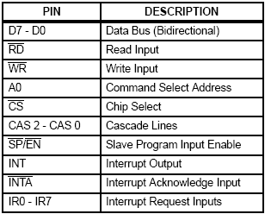
8259A- PIN OUT

Slide 39
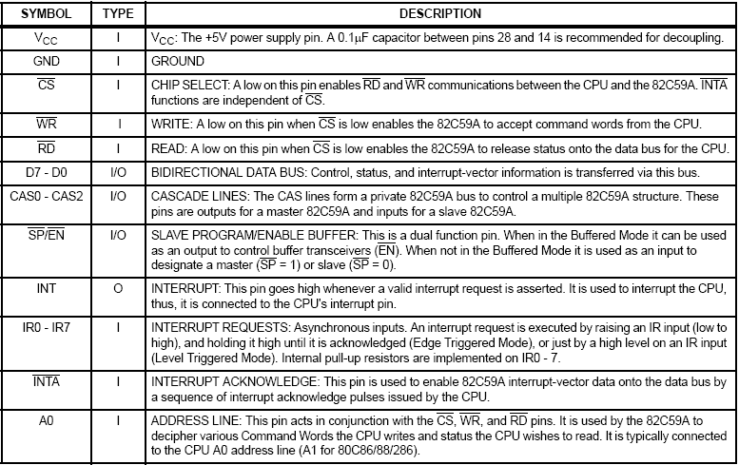
8259A- PIN DESCRIPTION

Slide 40
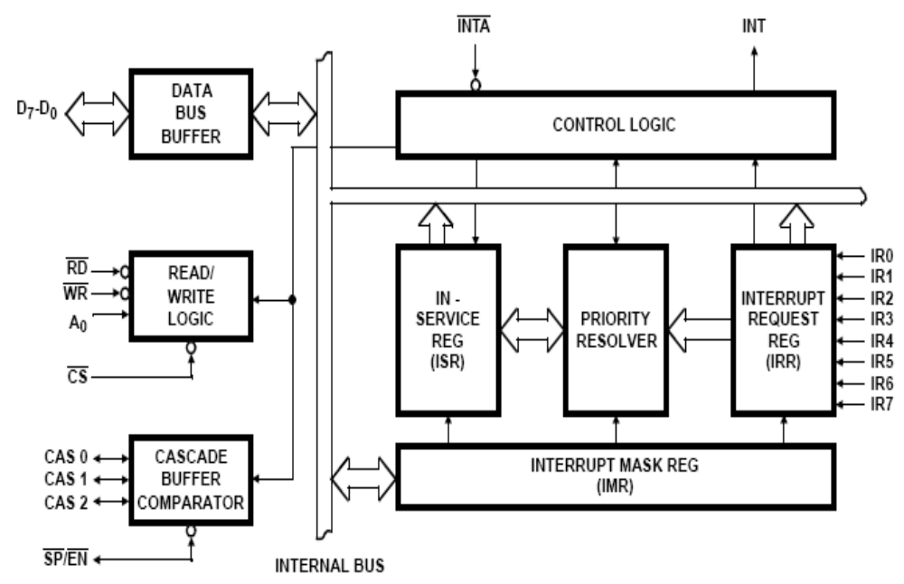
8259A-FUNCTIONAL BLOCK

Slide 41
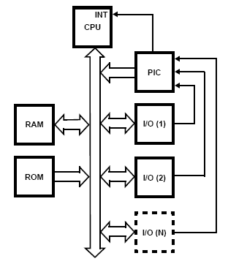
8259A-FUNCTIONAL DESCRIPTION
The Programmable Interrupt Controller (PlC) functions as an overall manager in an Interrupt-Driven system.
It accepts requests from the peripheral devices, determines which of the incoming requests is of the highest importance (priority), ascertains whether the incoming request has a higher priority value than the level currently being serviced, and issues an interrupt to the MPU based on this determination.
The PlC, after issuing an interrupt to the Processor, inputs the information to the Processor that can “point” the Program Counter to the service routine associated with the requesting device.

Slide 42
8259A- INTERRUPT PROCEDURE
I/O Devices can request for interrupt through the IR0-IR7 lines. The input requests are received and recorded in the 8-bit IRR register. IMR register (8-bit) holds the information about the masking of interrupt requests and the ISR register holds the information about the interrupt request currently under process. Whenever a new interrupt request appears on the IRR, the priority resolver checks the status of the IMR and ISR and the highest priority device is selected accordingly .

Slide 43
8259A- INTERRUPT PROCEDURE
These events occur during this:
1. One or more of the INTERRUPT REQUEST lines (IR0 - IR7) are raised high, setting the corresponding IRR bit(s).
2. The 8259A evaluates those requests in the priority resolver and sends an interrupt (INT) to the processor accordingly.
3. The processor acknowledges the lNT and responds with an INTA pulse.
4. Upon receiving an lNTA from the processor, the highest priority lSR bit is set, and the corresponding lRR bit is reset.

Slide 44
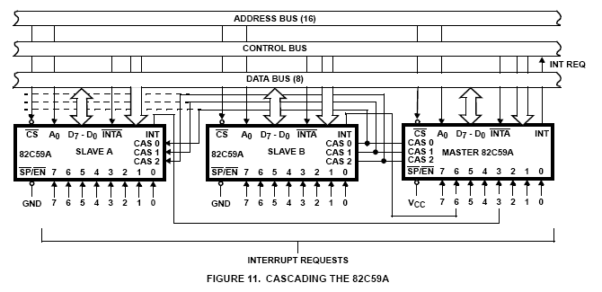
8259A-CASCADING

Slide 45
CASCADING
Cascade Mode
The 8259A can be easily interconnected in a system of one master with up to eight slaves to handle up to 64 priority levels.
The master controls the slaves through the 3 line cascade bus (CAS0,1,2). The cascade bus acts like chip selects to the slaves during the INTA sequence.
In a cascade configuration, the slave interrupt outputs (INT) are connected to the master interrupt request inputs (IR0…7). When a slave request line is activated and afterwards acknowledged, the master will enable the corresponding slave to release the device routine address accordingly.

Slide 46
Interrupts of 8085
On the basis of priority the interrupt signals are as follows
TRAP
RST 7.5
RST6.5
RST5.5
INTR
These interrupts are implemented by the hardware

Slide 47
Interrupt Instructions
EI ( Enable Interrupt) This instruction sets the interrupt enable Flip Flop to activate the interrupts.
DI ( Disable Interrupt) This instruction resets the interrupt enable Flip Flop and deactivates all the interrupts except the non-maskable interrupt i.e. TRAP

Slide 48
SIM (Set Interrupt Mask) This enables/disables interrupts according to the bit pattern in accumulator obtained through masking.
RIM (Read Interrupt Mask): This instruction helps the programmer to know the current status of pending interrupt.

Slide 49
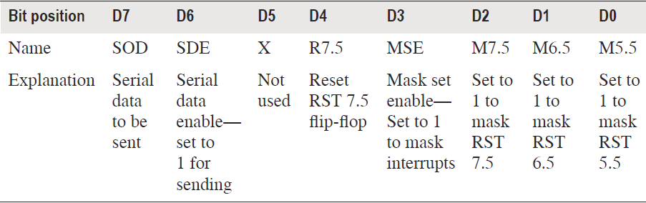
Accumulator bit pattern for SIM instruction

Slide 50
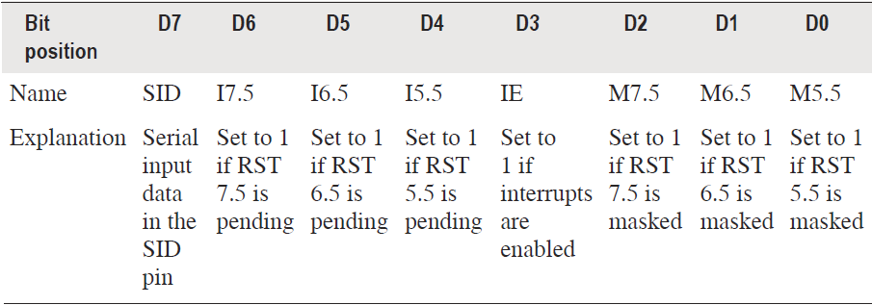
RIM Instruction

Slide 51
DMA
Programmed data transfers move data from memory to the accumulator, and then from the accumulator to the output ports.
A program has to be written to transfer data from a device to the memory in programmed data transfers. Thus the programmed data transfer is a slow process.
This causes a problem only while transferring large amounts of data.

Slide 52
DMA stands for Direct Memory Access. It is one of the ways to accomplish high-speed data transfers directly between memory and peripheral devices.
DMA is a method of data transfer between Memory and I/O devices without the intervention of microprocessor. This method is often used when large block of data is to be transferred.

Slide 53
DMA Data Transfer scheme
Data transfer from I/O device to memory or vice-versa is controlled by a DMA controller.
This scheme is employed when large amount of data is to be transferred.
The DMA requests the control of buses through the HOLD signal and the MPU acknowledges the request through HLDA signal and releases the control of buses to DMA.
It’s a faster scheme and hence may be used for high speed printers.

Slide 54
Processor provides starting address of the memory location from which the data is started,
The size (total number of bytes) of data to be transferred,
Control signal is used to decide the type of operation e.g. read, write.

Slide 55
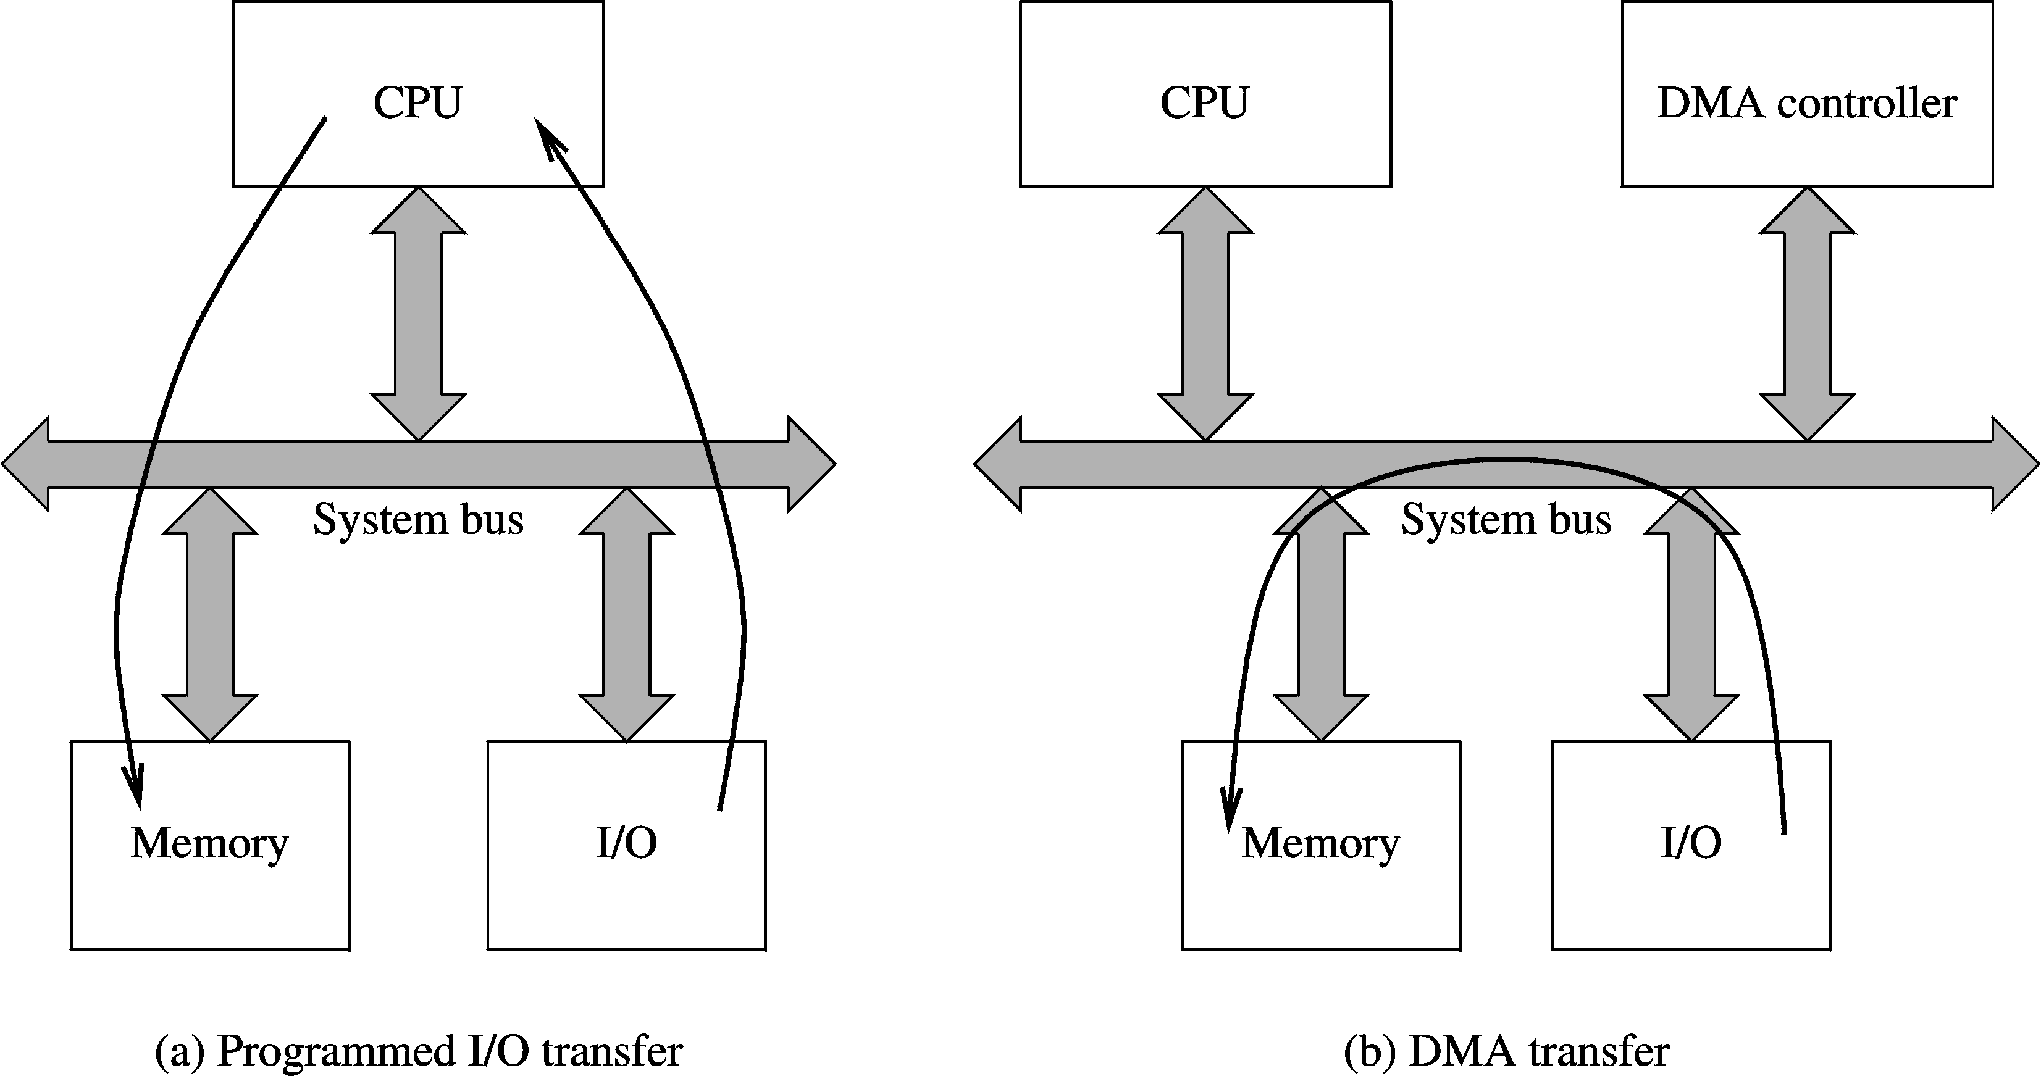
DMA Data Transfer (cont’d)

Slide 56
DMA Data Transfer (cont’d)
DMA is implemented using a DMA controller
  DMA controller
    Acts as slave to the processor
    Receives instructions from processor
    Example: Reading from an I/O device
      Processor gives details to the DMA controller
        I/O device number
        Main memory location (address)
        Number of bytes to transfer
        Direction of transfer (memory → I/O device, or vice versa)

Slide 57
DMA Data Transfer (cont’d)
Steps in a DMA operation
  Processor initiates the DMA controller
    Gives device number, memory buffer pointer, …etc.
      Called channel initialization
    Once initialized, it is ready for data transfer
  When ready, I/O device informs the DMA controller
    DMA controller starts the data transfer process
      Obtains bus by going through bus arbitration (taking bus from processor)
      Places memory address and appropriate control signals
      Completes transfer and releases the bus
      Updates memory address and count value
      If more to read, loops back to repeat the process

Slide 58
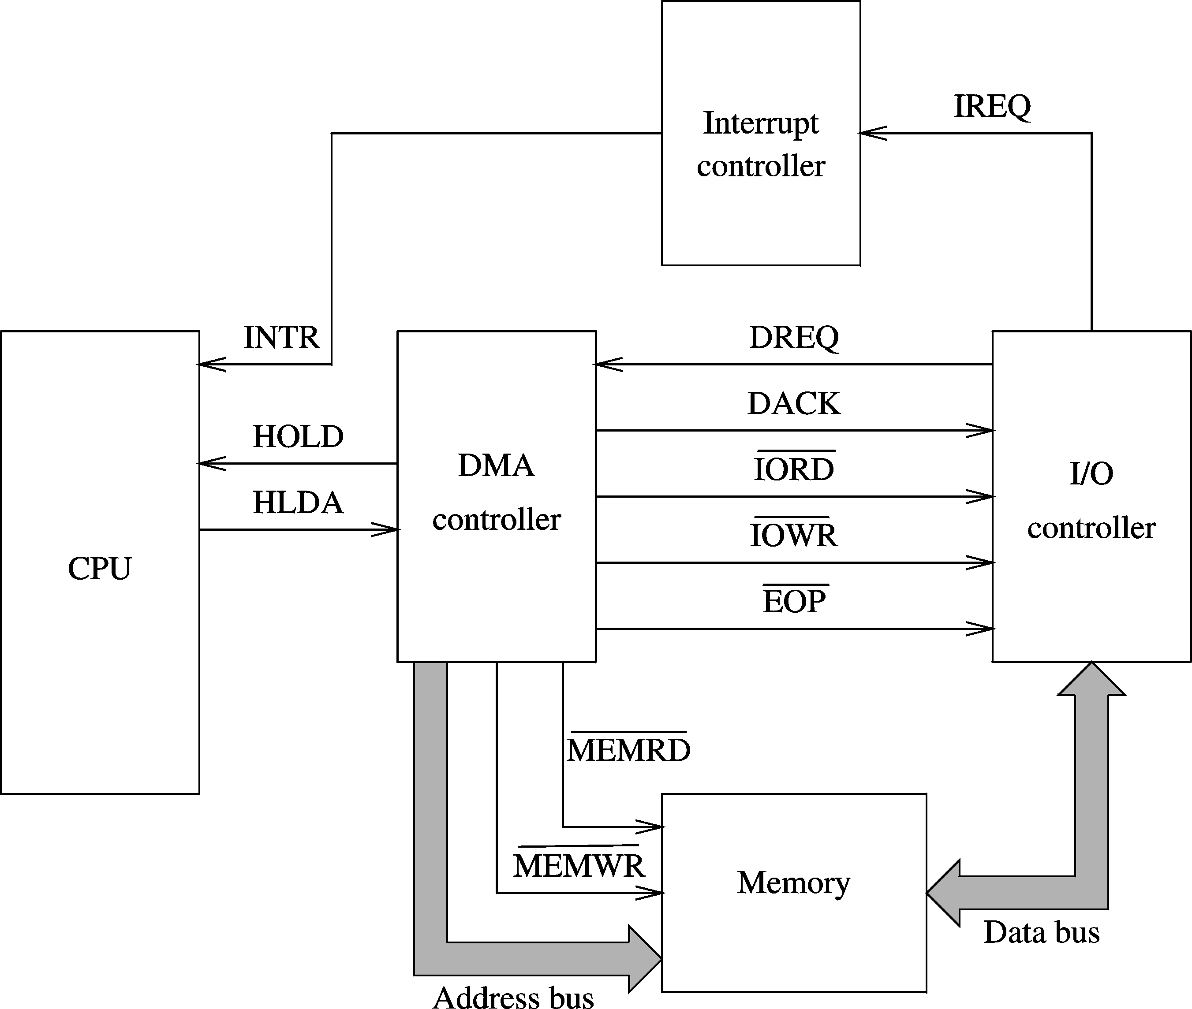
DMA Data Transfer (cont’d)
DMA controller details

Slide 59
DMA Controller
DMA controller commonly used with 8085 and 8088 processors is the 8237 programmable DMA controller device.
The 8237 is a 4-channel device. Each channel is dedicated to a specific peripheral device and capable of addressing 64 K bytes section of memory.

Slide 60
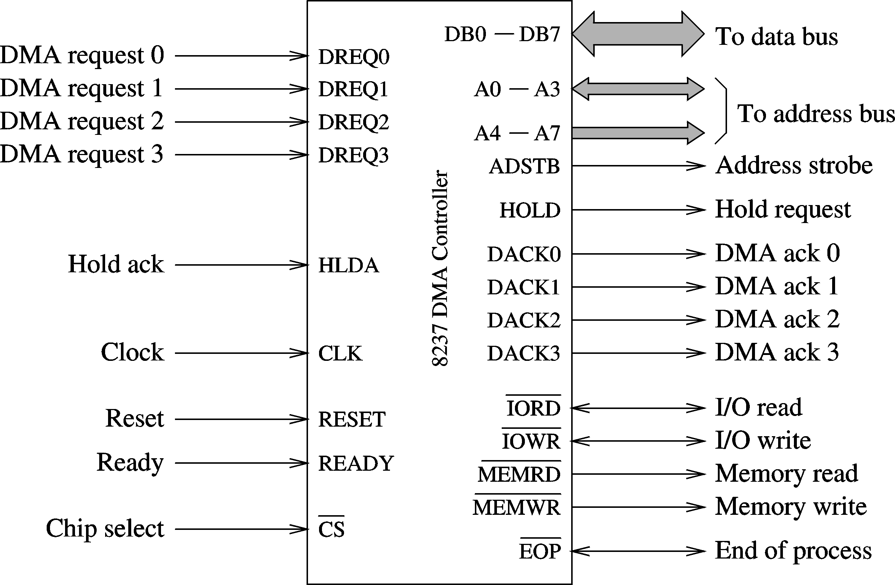
DMA Data Transfer (cont’d)
8237 DMA controller

Slide 61
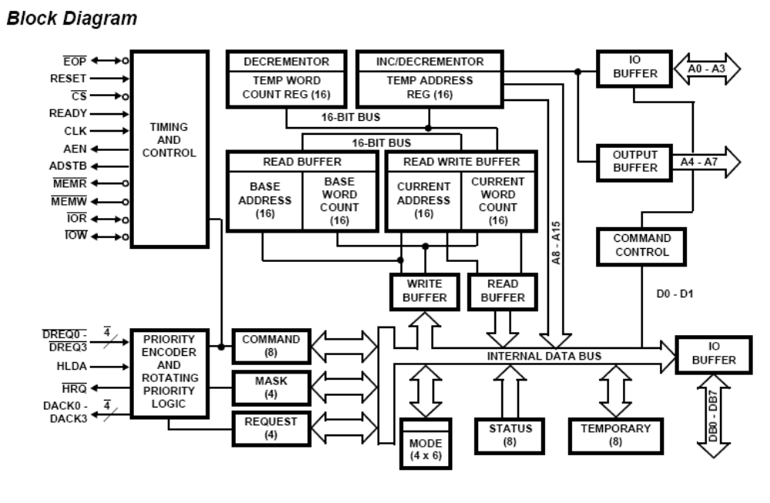

Architecture and pin details of 8237

Slide 62
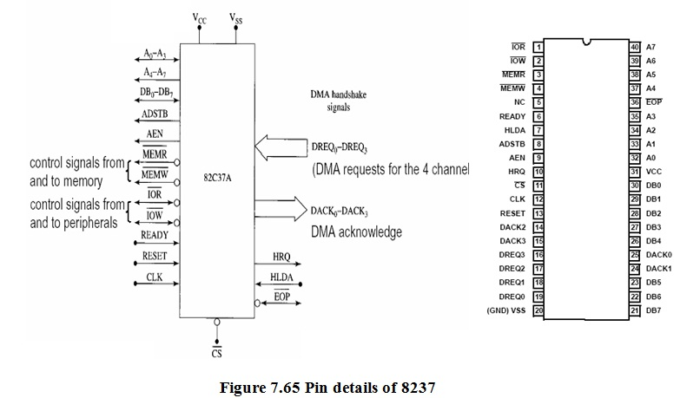

Slide 63
DMA Data Transfer (cont’d)
8237 supports four DMA channels
It has the following internal registers
  Current address register
    One 16-bit register for each channel
    Holds address for the current DMA transfer
  Current word register
    Keeps the byte count
    Generates terminal count (TC) signal when the count goes from zero to FFFFH
  Command register
    Used to program 8257 (type of priority, …)

Slide 64
DMA Data Transfer (cont’d)
  Mode register
    Each channel can be programmed to
      Read or write
      Auto-increment or auto-decrement the address
      Auto-initialize the channel
  Request register
    For software-initiated DMA
  Mask register
    Used to disable a specific channel
  Status register
  Temporary register
    Used for memory-to-memory transfers

Slide 65
The following sequences explain the DMA method of data transfer in detail.
The starting address of the data is loaded into the 8237 Current and Base Address registers for a particular channel, and the length of the block is loaded into the channel’s Word Count Register.
The corresponding Mode register is programmed for a memory-to-I/O operation (read transfer), and various options are selected by the Command register and the other Mode register bits.
The channel’s mask bit is cleared to enable recognition of a DMA request (DREQ). The DREQ can either be a hardware signal or a software command.

Slide 66
When the peripheral device has the first byte of data ready, it sends a DMA request - DREQ signal to the DMA controller.
If the input (channel) of the DMA controller is unmasked, the DMA controller will send a hold-request - HRQ signal to the microprocessor HOLD input.
The microprocessor will respond to this input by floating its buses and sends a hold-acknowledge signal, to the DMA controller.

Slide 67
When the DMA controller receives the HLDA signal, it will send out a control signal disconnects the processor from the buses and connects the DMA controller to the buses.
When the DMA controller gets control of the buses, it sends out the memory address where the first byte of data from the peripheral device is to be written.
Then the DMA controller sends a DMA-acknowledge, DACKO, signal to the peripheral device to tell it to get ready to the byte.

Slide 68
Finally, the DMA controller asserts both the and the lines on the control bus.
Asserting the signal enables the addressed memory to accept data written into it.
Asserting the signal enables the disk controller to output the byte of data from the disk on the data bus.
The byte of data then is transferred directly from the peripheral device to the memory location without passing through the CPU or the DMA controller.

Slide 69
When the data transfer is complete, the DMA controller unsets its hold-request signal to the processor and releases the buses. This lets the processor take over the buses again until another DMA transfer is needed.
The processor continues executing from where it left off in the program.
The entire process is explained with the flowchart given in next slide figure 7.74.

Slide 70
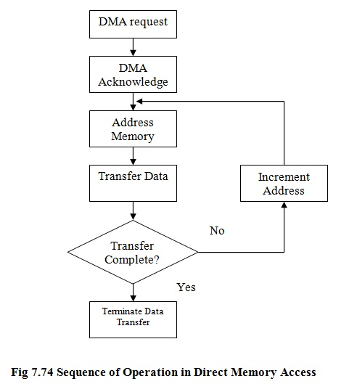

Slide 71
Block mode of data transfer
In this scheme the I/O device withdraws the DMA request only after all the data bytes have been transferred.
Cycle stealing technique
In this scheme the bytes are divided into several parts and after transferring every part the control of buses is given back to MPU and later stolen back when MPU does not need it.

Slide 72
SERIAL MODE OF DATA TRANSFER
There are typical situations where serial mode of data transfer is required like:
1. The serial mode is used for cost considerations as it requires only one pair of wires for data transfer.
2. Availability of suitable serial communication media for long distance transfer e.g. telephone network.
3. Inherent characteristics of many I/O devices forces the processor to store and retrieve data in serial mode e.g. printer, tape etc.

Slide 73
Serial data transfer contd..
Drawback of parallel data transfer:
a) The parallel data transfer has the drawback of many wires needed to transfer all the bits of data.
b) So, the parallel data transfer can not be effectively used for long distance transfers.
c) As one wire is used for each bit, byte wise data transfers are eight times more expensive than a single bit transfer.
Serial data transfer is the solution for data transfers over long distances.
Also, serial communications are low cost way to send data over long distances.

Slide 74
MODES OF SERIAL DATA TRANSFER
Simplex mode: Data transfer takes place only in one direction. e.g. from a computer to a remote printer.
(ii) Full duplex: There are two serial links one for each direction. Data transfer can take place in both directions independently and simultaneously.
(iii) Half-Duplex: Data transfer in both directions can be achieved by using a single link. However, it needs some protocol to be established to determine the direction of the link (typical wireless set of police deptt. ).

Slide 75
IO Addressing
In programmed IO the CPU, main memory and IO devices communicate via the system bus.
The address bus lines of the system bus that are used to select memory locations are also used to select IO devices.
The IO devices are connected to the system bus via IO ports. IO ports are a little different than memory locations.
There are two different methods of IO addressing namely ‘Memory Mapped IO’ and ‘IO Mapped IO’.

Slide 76
Memory Mapped I/O
In memory mapped I/O, each input device or output device is treated as if it is a memory location.
The control signal for read and write operation of I/O device is same as that of memory chips.
Each input or output device is identified by a unique address in the memory address range.

Slide 77
Memory Mapped IO
It assigns a part of main memory address space to IO ports.
The system uses same address space for both memory and IO.
The CPU treats an IO port register as being part of the memory system .
A memory referencing instruction that loads or stores instruction at an address X can also be used to access an IO instruction if X is made the address of an IO port.
The same memory load and stores instructions are used to transfer data words to or from IO ports.

Slide 78
No special IO instructions are needed.
The same read and write control lines are used to initiate IO transfer. All the memory related instructions used to read data from memory are used to access input and output device.
(viii) Since the I/O devices use some of the memory address space, the maximum memory addressing capacity will be reduced in a microprocessor based system.

Slide 79
I/O mapped I/O data transfer
In ‘I/O mapped I/O’ device data transfer method, the I/O devices are treated separately from memory.
Separate address range will be assigned for the input and output devices.
The signals for read and write from I/O devices are completely separate from the signals used for memory access.

Slide 80
IO Mapped IO
(i) The memory and IO address spaces are separate.
(ii) Separate control lines for memory and IO reference.
(iii) A memory referencing instruction activates Read M and Write M control lines which does not affect the IO devices.
(iv) CPU must execute separate IO instructions to activate Read IO and Write IO lines.
The IO device and memory location can have the same address.
When the CPU fetches and decodes IO instruction, it places the address associated with the instruction onto
the common address lines.

Slide 81
IO Mapped IO
(vii) Similarly for memory accesses the CPU enables the Read M and Write M control lines.
(viii) The microprocessor will have separate instructions for Input and output device access such as IN instruction and OUT instruction of 8085.
(ix) As the memory and I/O device access is completely different, a single address can be assigned to both an I/O device and a memory location.

